Slide 1
Integration to SAP

Slide 2
Topics
Customer use cases for a Workday to SAP integration
Architecture and components involved
Challenges and lessons learned
Design and Implementation Steps

Slide 3
Use Case – 1
Customer’s SAP landscape consisted of:
Global SAP system for HR, time tracking and expenses
Regional Financial systems for North America, Europe, MEA and Asia Pac
SAP HR integrated to regional Financial systems via custom ALE technology
Global implementation of Workday HCM
Workday to SAP Global integration
Existing ALE links continue to feed regional Financial systems

Slide 4
Use Case – 1 cont’d
Before Workday
After Workday
SAP Financials Europe
Workday Global HCM
SAP Financials Europe
SAP Global (HR, Payroll, Time Tracking)
SAP Financials Asia Pac
SAP Global (Payroll,
Time Track)
SAP Financials Asia Pac
ALE Links
ALE Links
SAP Financials MEA
SAP Financials MEA
Integrations
Integrations
External Systems
External Systems

Slide 5
Use Case – 1 cont’d
Workday to SAP outbound integration feeds:
Worker data to continue usage of time tracking module
Worker data in the regional finance systems for workflow / approvals, etc
Existing integrations from SAP to other downstream systems (e.g. contingent workforce system, performance management)
SAP to Workday – Cost Centers inbound integration
Add / update cost centers in Workday

Slide 6
Use Case – 2
Customer’s SAP landscape consisted of:
HR and payroll system for a specific region
Workday HCM implemented to replace SAP HR
Workday to SAP outbound integration feeds:
Worker data – personal, job, compensation, etc
Org data – to feed OM module in SAP

Slide 7
Integration Architecture
Workday
SAP PI
Foundation Data
Organization Name and ID
Parent org
Position Title and ID
Job Profile Name and ID
Relationships
etc.
SAP OBJID mapping/cross reference
Additional transformation or business logic
Push to SAP
Organizations Connector and Web Services
Custom Transformation & Delivery
(Studio)
Positions Connector and Web Services
Idoc XML over HTTPS
Job Profiles Connector and Web Services
HCM Connector and
Get Workers WS
Worker Data
Personal Info (Name, Address)
Status Data (Staffing event, active status)
Job Data (Position, Organization, Manager)
Govt IDs
Earnings and deductions
One time payments
Dependents
etc.
SAP Global System
Consolidate data to get Full Effective Stack of all Worker Transactions
(Studio)
Transformation to Idoc & Delivery
(Studio)
Idoc XML over HTTPS
Notes:
Typically an SAP PI or a similar middleware consumes data sent by Workday. The middleware then maps the data into SAP specific fields.

Slide 8
Lessons Learned
Simplify integration requirements where possible
E.g. retro-active changes on certain objects such as job profiles or getting to the right effective date – consider defaulting the BEGDA
Maintain minimum data in sap to serve functionality
E.g. If SAP is only going to run payroll then consider simplifying OM module
Consider rewriting integrations than to maintain large number of fields/functionality in sap
Work with the data conversion team during integration design to identify fields that are specific to the integration but do need to be stored in Workday
Iterative approach of development – few infotypes at a time
Buy in of all teams - sap design, dev involved
Notes:
If SAP does not need certain pieces of data then best to leave those off from the integration
Keep integration design flexible so that adoption of new features not constrained by integration -

Slide 9
Design and Implementation Steps
Agree on architecture and components involved
Mapping and cross-reference tables
Transport type
Change detection and effective dated logic
Mapping and Transformation
List the infotypes to be created based on the modules enabled in SAP – Personnel Administration (PA), Organization Management (OM), etc.
Identify data sources in Workday – web services, custom reports
Review mapping of fields
Build and Test
Iterative approach works best
Create file to import into SAP

Slide 10
Product Plans

Slide 11
Workday to SAP HR Integration (proposed approach)
Master Data
Workday-built SAP Integration Systems
(Customizable)
Master Data
SAP
Workday
HCM
IDoc
Connectors
IDoc
Configuration
Configuration
Adopt SAP ALE IDoc integration technique to support Workday integration with SAP ERP. Utilize Workday Studio to facilitate data transformation, transmission between SAP and Workday for master data and configuration elements.
Minimize custom SAP development effort, knowledge transfer, on-going IT support by using existing SAP provided ALE integration scenarios and IDoc handling, processing capabilities
Contain data transformation logic and business rules within Workday Studio instead of SAP to provide accessible and repeatable integration technique
Minimize SAP version compatibility, SAP system upgrade impacts by adopting SAP provided and supported integration technique
Minimize Workday system upgrade impacts on SAP ERP by standardizing data transfer mechanism
Workday and SAP ERP Mini-Master Integration Scenario (minimum required for SAP ERP integration)
Master Data Integration:
Workday to SAP ERP Workday Data: Business Process, Worker Company Organization, Worker Cost Center Organization, Worker Employee Type, Worker Last Name, Worker First Name
SAP ERP to Workday SAP Data Element: Cost Center
Configuration Integration:
SAP Enterprise Structure to Workday SAP Data Element: Company Code
Workday to SAP HR Enterprise Structure Workday Data: Supervisory Organization, Business Site Organization, Region Organization, Employee Type

Slide 12


SAP Integration
Action
Org Assignment
Hire Employee
Personal Data
Addresses
Basic Pay Data
Bank
Etc
Notes:
<click>
Let's see how SAP wants to see the data. Here's an example of a hire employee in Workday
<click>
SAP first wants to know the action that happened. We've hired an employee so we have to specify that SAP action corresponding to Workday's hire.
We also need to let SAP which organizations a person belongs to, their personal data, etc. Additionally, the records sent vary based on transaction.
If I make a compensation change, I don’t worry about sending address data. And if there was more than one transaction, I need to send them separately so
SAP can re-create the history in the right sequential order.
<click><click>
Data is then sent to SAP.
Repeat this process for all other Workday transactions.

Slide 13
SAP Project
W20
“Design only” for effective stack technology (prototype)
“Design only” for parallel processing (prototype)
“Design only” for SAP integration
W21
Build effective stack solution & parallel processing
Build initial countries for SAP
Available for design partners only
W22
GA
Design Partner Program
Kickoff in May

Slide 14
Salesforce.com

Slide 15










Workday & Salesforce.com Integrations
System of record for People, Spend, Financials, Work
1
Delivered Apps
2
Collaboration
3
Platform

Slide 16
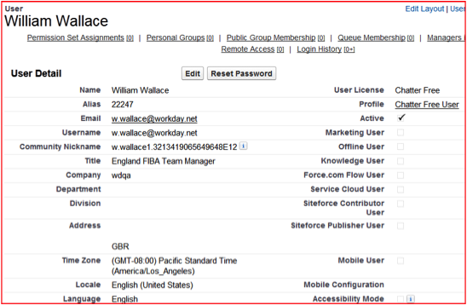
Provisioning and Worker Profile

Slide 17
Workday for Sales Cloud
Track Cost by Opportunity
Enable organizations to track and analyze expenses and POs by “opportunity” and “prospect” in Sales Cloud
Generate Customer Invoices
Create new customers and generate invoices based on “Closed/Won Opportunities” in Sales Cloud
Manage Customer Activity Details and View Customer Balance
View approved customer activity (e.g. invoicing, payments, returns) and customer account balance

Slide 18
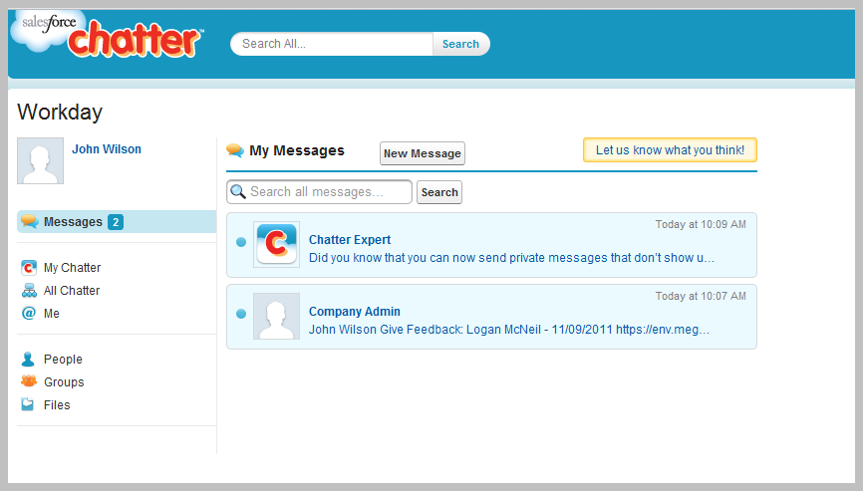
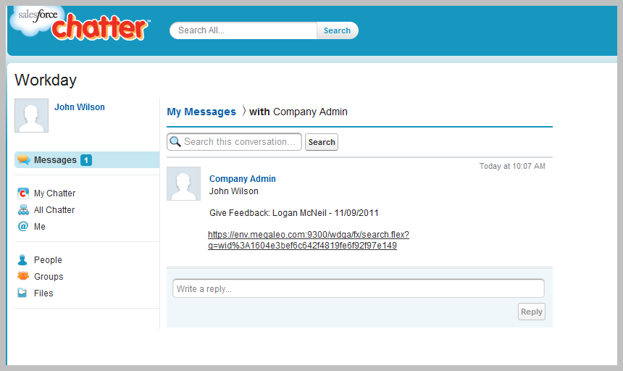


Workday for Chatter (v1): Private Messages

